Slide 1

Project 2: are all stock market models equal?
Sharod – Pankaj - Tarik

Slide 2


Slide 3


Long-term approach – trend vs exact price (day-trading)
3 portfolios
Technology Portfolio
Industrial Portfolio
S&P 500
Economic Data
Google Pytrends Keywords
Time Constraints
Data issues
Model Building

Slide 4

Models summary
Linear Regression
Sequential Model – Portfolio Value
Sequential Model – with Economic data
Sequential Model – with Google Pytrend (keywords)

Slide 5

Data cleanup
Types of data
Stock data for ten stocks and the S&P 500, meant to represent technology focus companies and industrial focus companies
Portfolio 1: S&P 500
Portfolio 2: Tesla, Apple, Microsoft, Amazon, and Netflix
Portfolio 3: Ford, General Motors, General Electric, Chevron, and Exxon Mobil
United States economic data including Gross Domestic Product (GDP), Consumer Price Index (CPI), Unemployment Rate (UR), Industrial Production Index (IPI)
Google Trend data for keywords related to the stocks pulled

Slide 6
Data cleanup
Cleanup process
Data obtain is from January 1, 2013 to March 31, 2021
The three portfolios were set to an initial value of $100,000.00 on January 1, 2013
The fillna function was used to fill in weekend and holiday close prices with that of the previous business day
The fillna function was also sued to fill in missing economic data with the previous value

Slide 7
Model training
For each portfolio, in addition to Ford and Tesla stocks, the following models where created
Linear Regression model using the portfolio value as the features
Deep Learning (Sequential) using the portfolio value as the features
Deep Learning (Sequential) using the economic indicators
Deep Learning (Sequential) using the Google trends as the features
Training and testing data was split 70% to 30% respectively
X and y data scaled using MinMaxScaler()
Sequential model with four layers
Optimizer used “adam”

Slide 8
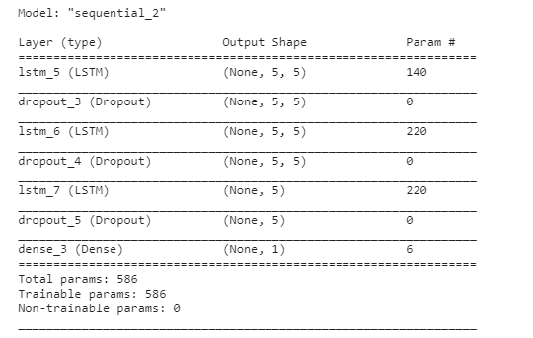
Model training
To train the model:
Epochs = 50
Shuffle = False
Batch size = 5
Verbose = 1

Slide 9
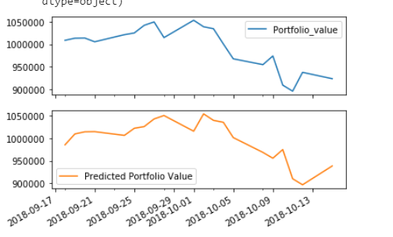
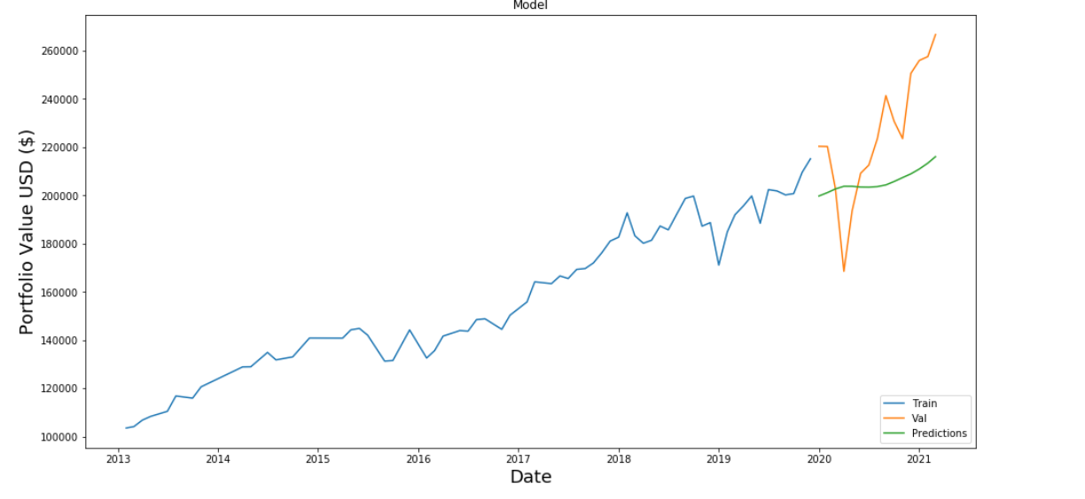
Model evaluation – technology portfolio
Linear Regression Model
RMSE: 8,552.08
DEEP LEARNING Model
RMSE: 19,254.156

Slide 10
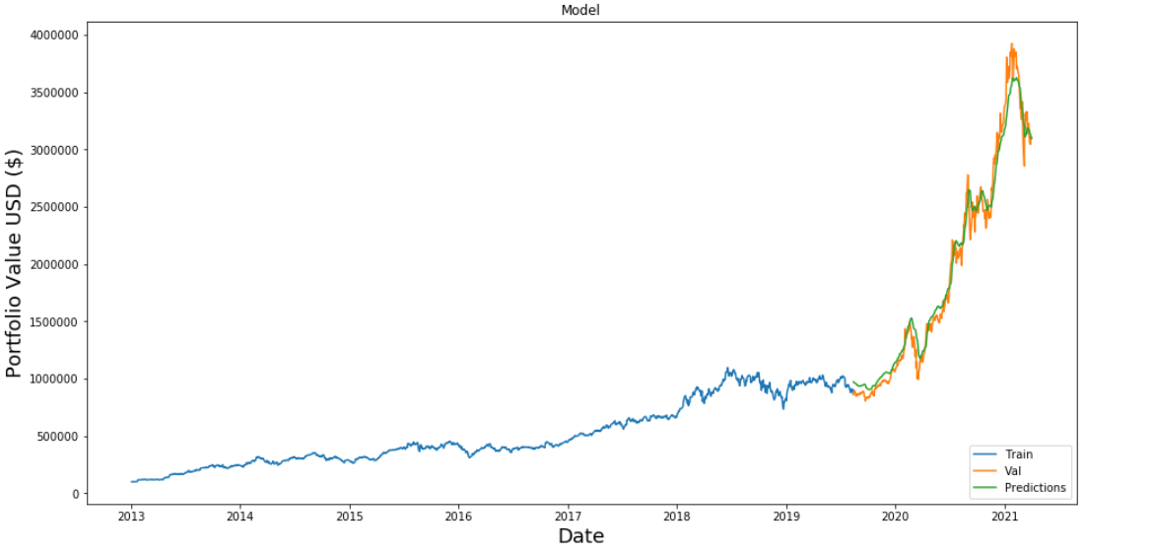
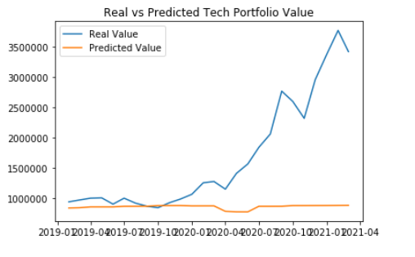
Model evaluation – technology portfolio
Deep learning Model
RMSE: 253,351.88
DEEP LEARNING Model
RMSE: 52,490.89

Slide 11
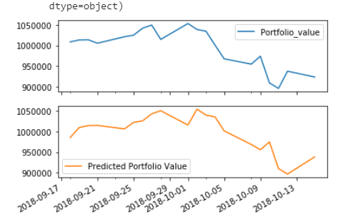
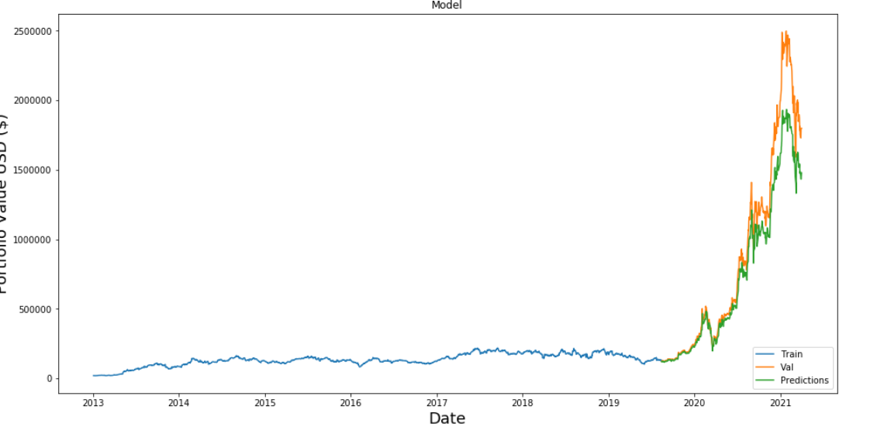
Model evaluation – tesla
Linear Regression Model
RMSE: 3,703.37
DEEP LEARNING Model
RMSE: 127,656.90

Slide 12
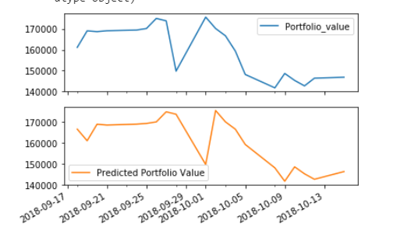
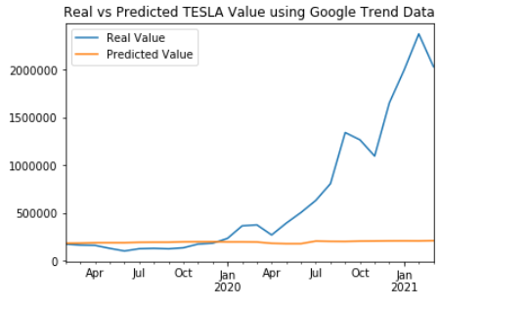
Model evaluation – tesla
DEEP LEARNING Model
RMSE: 178,487.02
DEEP LEARNING Model
RMSE: 294.52

Slide 13
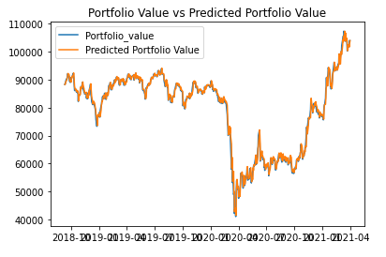
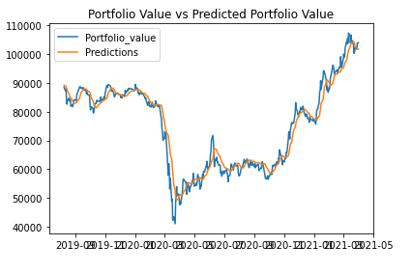
Model evaluation – industrial portfolio
Linear Regression Model
RMSE: 1046.23
Deep learning model
Rmse: 183.88

Slide 14
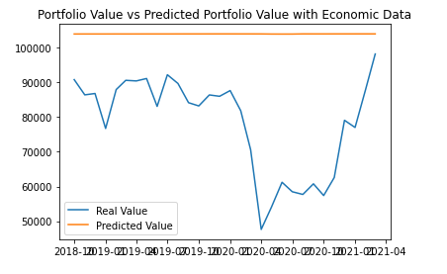
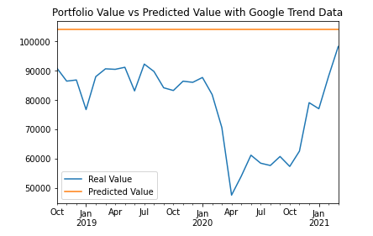
Model evaluation – industrial portfolio
DEEP LEARNING MODEL
RMSE: 24,531.08
Deep learning model
Rmse: 25,892.14

Slide 15
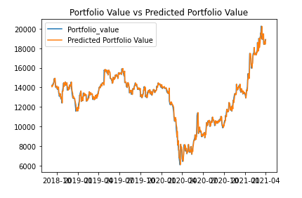
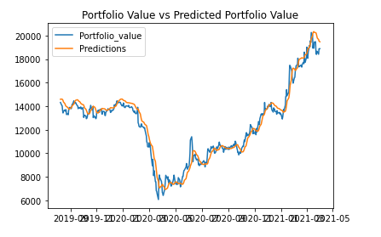
Model evaluation – FORD MOTOR COMPANY
Linear Regression Model
RMSE: 295.54
Deep learning model
Rmse: 126.92

Slide 16
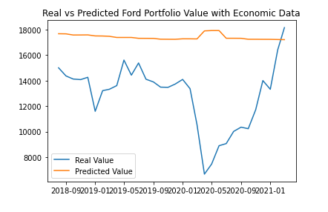
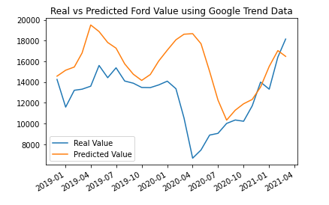
Model evaluation – FORD MOTOR COMPANY
DEEP LEARNING MODEL
RMSE: 4539.67
Deep learning model
Rmse: 2944.28

Slide 17
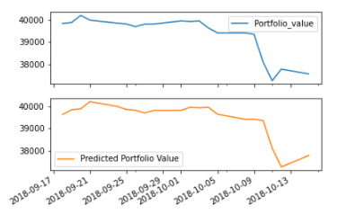
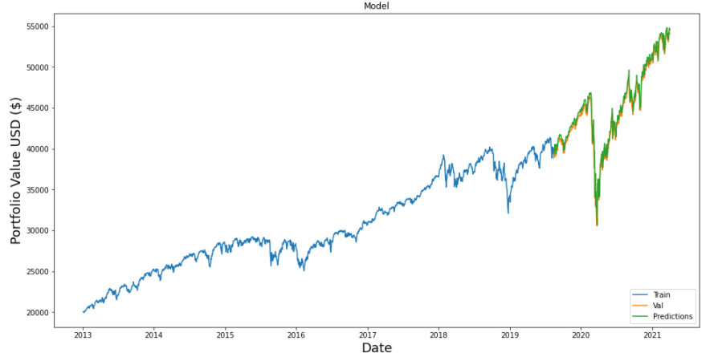
Model evaluation – S&P 500
Linear Regression Model
RMSE: 591.75
Deep learning - LSTM Model
RMsE: 1040.06

Slide 18
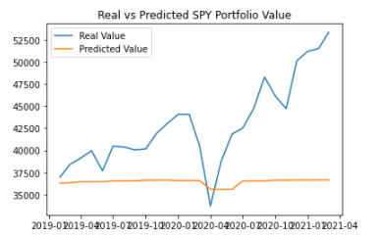
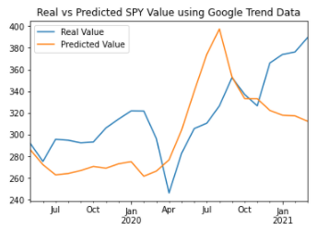
Model evaluation – S&P 500
Deep learning - sequential Model
RmsE: 276.48
Deep learning - sequential Model
RMSE: 301.82

Slide 19
Overall findings

Slide 20
Post-mortem
Difficulties – NLP data restriction
What would we research if we had more time?

Slide 21


